Slide 1
Machine learning for nuclear physics
Young-Ho Song
(RISP, Institute for Basic Science)
NPS2020, 2020.06.22
https://www.apctp.org/plan.php/nps2020

Slide 2
Disclaimer
Note that I am not an expert on Machine Learning, but a nuclear physicist who is interested in Machine Learning.
This lecture is just an introduction of basic concepts of Machine Learning , especially, a supervised machine learning called neural network.
My lecture does not cover wide range of artificial intelligence/ machine learning.
There are (too) many good resources about Machine Learning in internet.
My lecture is mostly based on those materials which was helpful for my understanding of Machine Learning.

Slide 3
Too many good resources
References
1. Deep Learning with Python, Francois Chollet
2. Neural Networks and Deep Learning, M. Nielsen
http://neuralnetworksanddeeplearning.com/
3. Machine Learning for Physicists, Florian Marquardt
https://machine-learning-for-physicists.org/
4. Machine Learning Crash Course, Google
https://developers.google.com/machine-learning/crash-course
5. A high bias low-variance introduction to Machine Learning for physicists, P. Mehta et al.
https://doi.org/10.1016/j.physrep.2019.03.001
And much more

Slide 4
Outline
Introduction
Basics of Machine Learning
Basics of Neural Networks
Some topics in ML
Applications of ML to Nuclear Physics
Programming will be explained at Exercise session

Slide 5
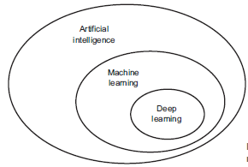
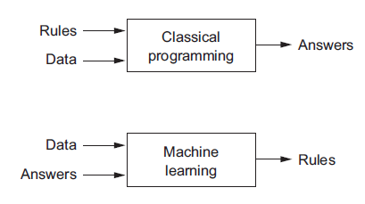
Machine Learning
What does it mean by machine “learning”?
ML is a subfield of artificial intelligence(AI).
The goal of ML is to create an algorithm from data automatically.
→ Pattern Finder
The algorithm created from data will be used to make prediction, making a decision to act.
Figures from Ref.1
Notes:
전통적인 프로그래밍에서는 사람이 룰/알고리즘을 주고 데이터를 입력하면, 결과를 주도록 되어 있다. Machine learning에서는 데이터와 우리가 얻고 싶은 결과를 입력하여 컴퓨터가 최선의 방법을 스스로 찾도록 한다.

Slide 6
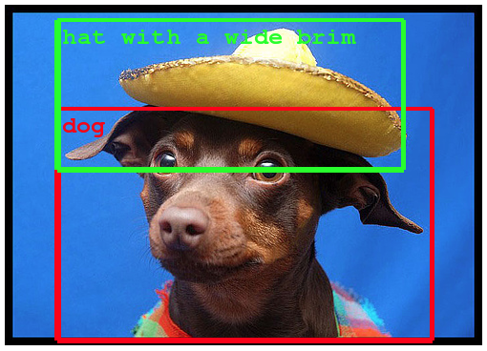
Machine Learning
It is possible to make machine “learn” even when the programmer does not know how to do it exactly.
It can only learns within given model space.
Recent popularity of ML mainly from the success of Deep Neural Networks(very large model space).
Example of Object Detection within Photogaphs Taken from the Google Blog.
Figures from Ref.1
Notes:
전통적인 프로그래밍에서는 사람이 룰/알고리즘을 주고 데이터를 입력하면, 결과를 주도록 되어 있다. Machine learning에서는 데이터와 우리가 얻고 싶은 결과를 입력하여 컴퓨터가 최선의 방법을 스스로 찾도록 한다.

Slide 7
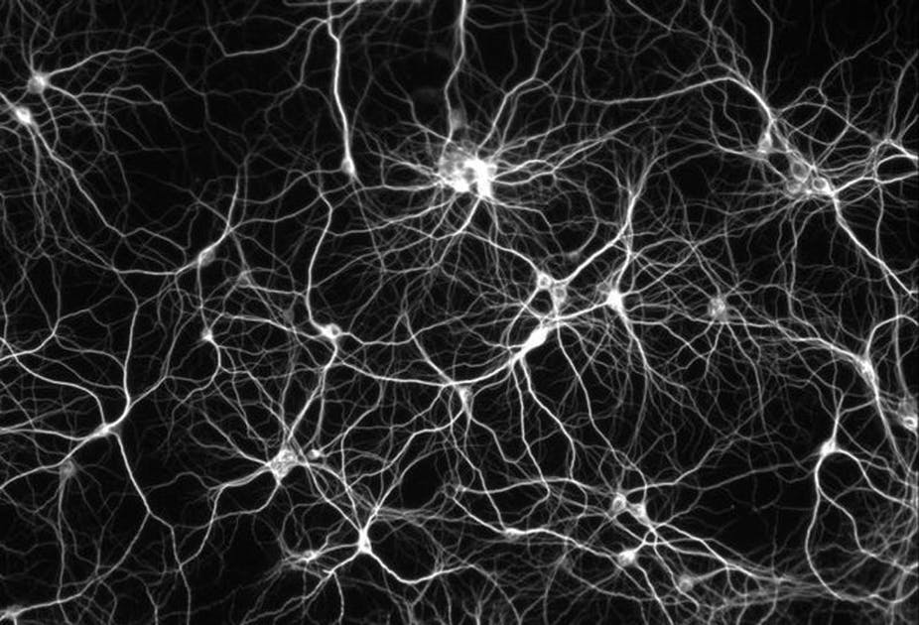


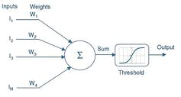
Neural Network and Deep Learning
Artifical Neural Network(ANN)
One of the ML methods inspired from the neuron of brain.
Deep Neural Network(DNN)
Many hidden layers of neurons
Images from Wikipedia

Slide 8
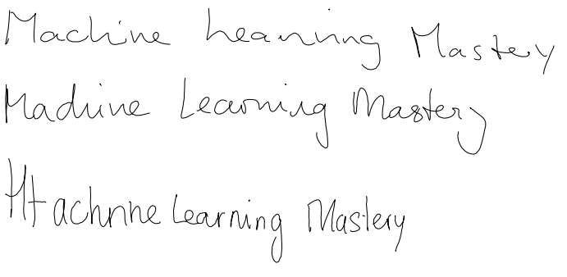
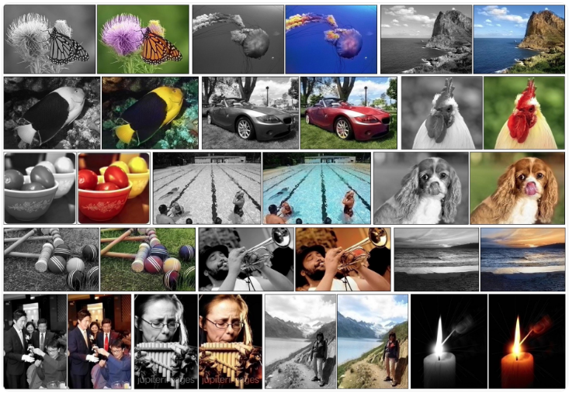
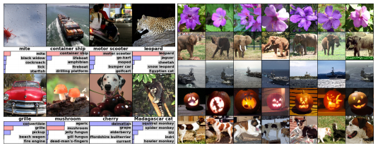
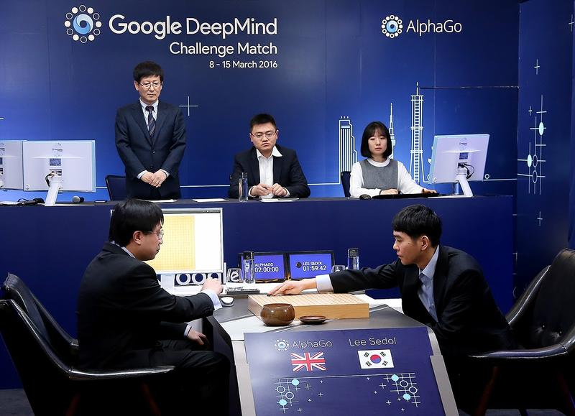
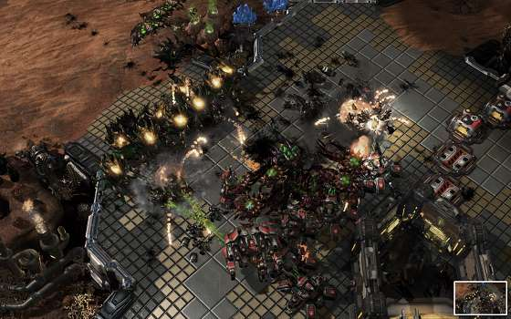
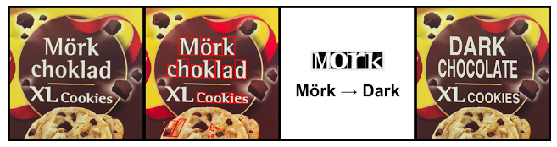
Machine Learning
Examples of Machine Learning(actually deep learning)
Image Recognition
Colorize image
Automatic translation
Automatic hand writing/image generation
Automatic text generation
Game Playing
And so on…
https://machinelearningmastery.com/inspirational-applications-deep-learning/

Slide 9
Application of ML for nuclear physics
A.I. for Nuclear Physics arXiv:2006.05422v1 and more
Later in lecture, we will look into more details of several works.
Lattice QCD : reducing sign problem, cheaper/faster generation of new configuration, propagator inversion, extraction of physical observables ….
modelling nuclear masses and other observables, fast emulation for big simulations, identifying crucial experimental data for better constraining theory, uncertainty quantification of theoretical results…
Accelerator and material design optimization, Dynamic optimization of real time operation controls, data classification and regression, triggering …

Slide 10
Three large classes of Machine Learning
Supervised learning
Learn from examples( data = features +labels)
Labels : things we want to predict , answers, y
- Cats and Dogs, mass of nucleus …
Features: input variables, x
- images, (A, Z) …
Examples : labeled examples = set of (features x, labels y)
unlabeled examples = (features, ?)
Models : relationship between features and labels, y = f(x)
Training/Learning : change models gradually to make the model make a better relation between feature and label
Inference : apply the trained model to unlabeled examples. Prediction.

Slide 11
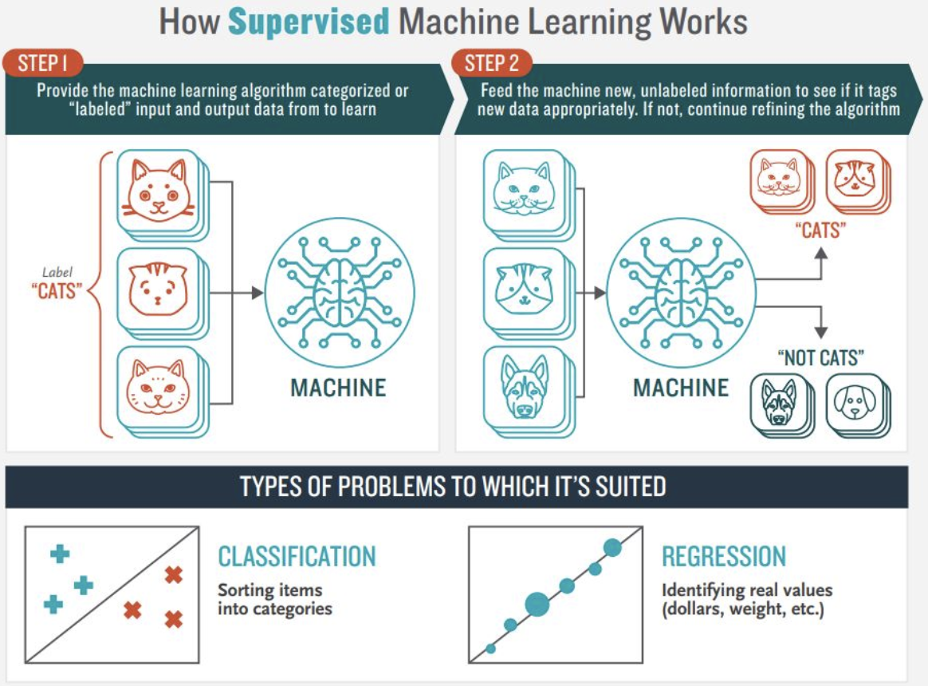
Three large classes of Machine learning
Supervised learning
Classification: Prediction of discrete values
Regression : Prediction of continuous values
Parametric method
y = f(x; p)
Linear Regression, Neural Networks…
Non-parametric method
Parameters are determined by the data y=f(x;p(data))
Lagrange interpolation,SVM, Gaussian Process …
Image from medium.com blog

Slide 12
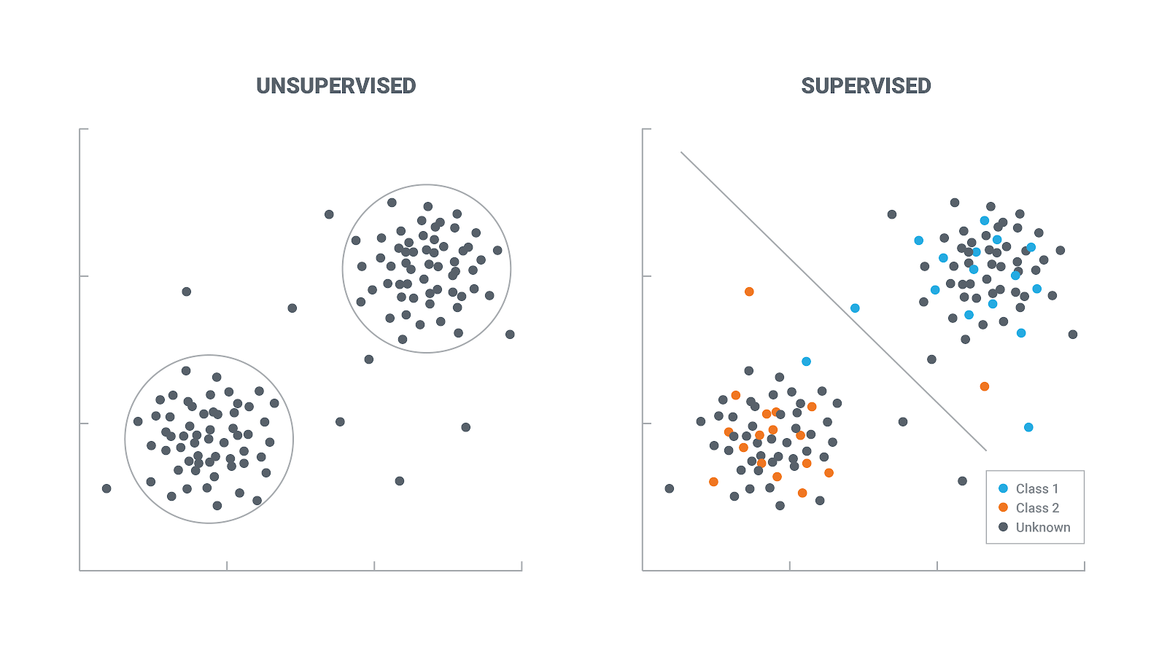

Three large classes of Machine learning
Unsupervised learning
Finding patterns and structure from unlabeled data
Clustering: classify data according to their features
Images classified without telling cats and dogs
Dimensionality Reduction: reduce number of input variables in a dataset
What is important in the inputs ?
Generative Modeling : generate new data
Create a new image of cats and dogs.
Image from https://lawtomated.com
Image from Ref.4

Slide 13

Three large classes of Machine learning
Reinforcement learning
Interact with environment and act to maximize reward
Try to find a best strategy automatically
This Lecture focuses on Supervised Learning( ANN )
Image from Wikipedia

Slide 14
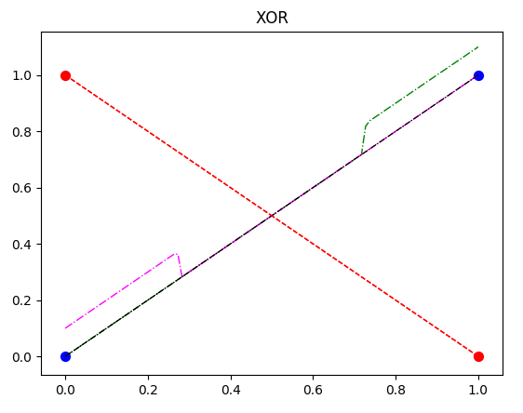
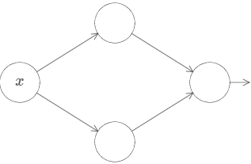
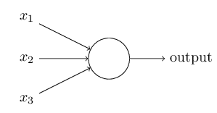
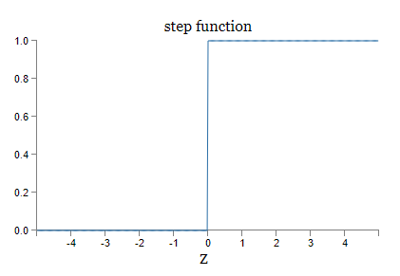
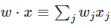
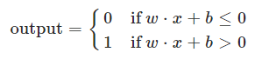
Perceptron/Neuron
Perceptron : weights, bias
- weights (w) and bias (b) are adjusted/trained.
- can be used to compute logical functions
- Example: elementary logical functions
(1) w1=-2, w2=-2, b=3 → NAND function
(2) w1=2, w2=2, b=-1 → OR
(3) problem: construct AND function
(4) problem: Can one make XOR function ?
→ not possible with one perceptron. Why?
→ possible with two perceptron. How?

Slide 15
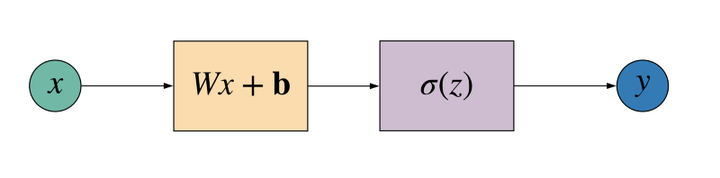

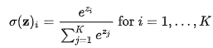
Perceptron/Neuron
Neuron: sigmoid (or other non-linear) activation function
Common activation functions
Identity
Step
Sigmoid
ReLU(rectified linear units)
ELU(Exponentioal linear units)
Tanh
Softmax : classification
More details will be given later
Graph from bolg in medium.com

Slide 16
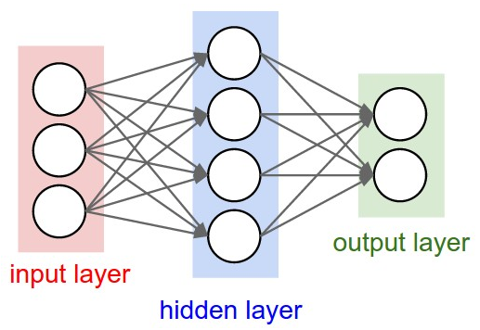
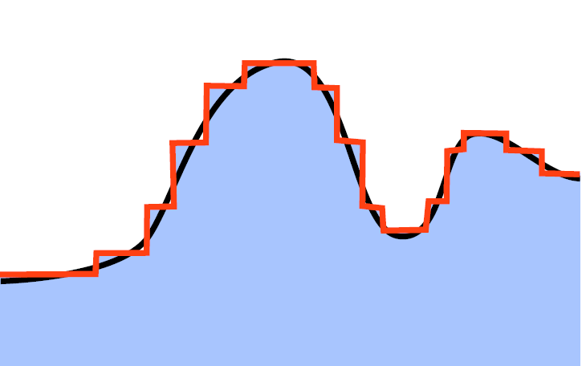
NN as a Universal Approximator
Universal approximation theorem:
Roughly speaking, with enough number of perceptrons in a hidden layer, one can approximate any continuous function f(x).
→Can be proved mathematically. (George Cybenko 1989 for sigmoid)
→Can be extended to multi-dimensional function
→Can be extended to any non-linear activation function
Meaning: One can use NN as a universal approximator of complicate non-linear function.
→ How one can actually make it for a specific problem?
Image from Ref.3

Slide 17
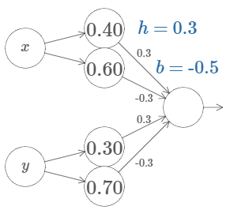
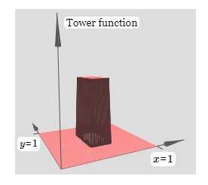
NN as a Universal Approximator
http://neuralnetworksanddeeplearning.com/chap4.html
Problem: 2-D case, f(x,y)
Can you make a tower like 2-D function with neurons?
Finding correct parameters(weight/bias) manually is too cumbersome
→ Need a better way

Slide 18
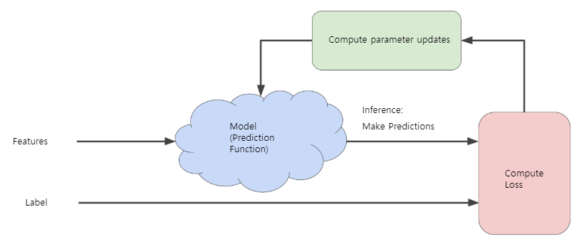
How to train NN (supervised learning)
Image from Ref.4
Loss/Cost/Risk : measure whether the algorithm is doing a good job
→ Mean squared error, cross-entropy …
Learning/Training: update parameters of model to reduce Loss.
→ Optimizer ( Gradient descent ,SGD, … )

Slide 19
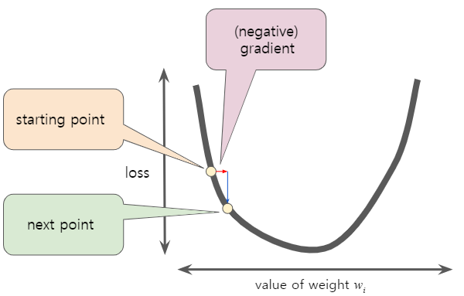
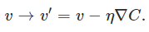
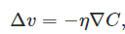
Gradient Descent
Optimizer : update parameters to reduce Loss.
Gradient descent : Change parameters
To the direction of
negative gradient of Loss function
Learning rate:
How much we change parameters
In each step.
Image from Ref.4

Slide 20
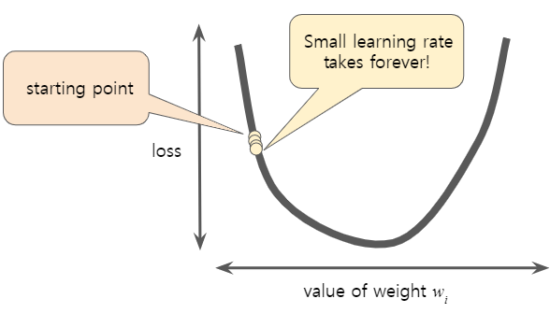
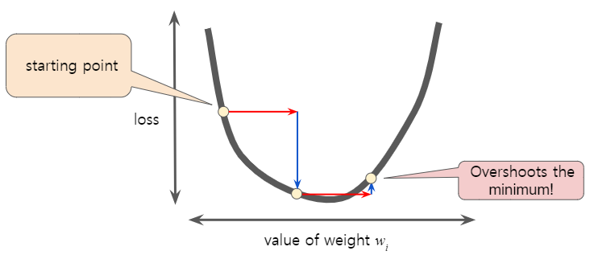
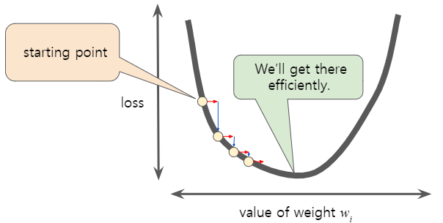
Gradient Descent
Epoch: using entire data to update parameter
→ In GD, one step=one epoch
Limitations of GD (Ref 5.)
GD finds local minima of the cost function
GD is Computationally expensive for large datasets
GD treats all directions in parameter space uniformly
GD is sensitive to initial conditions
GD can take a lot of time to escape from saddle points
Images from Ref.4

Slide 21
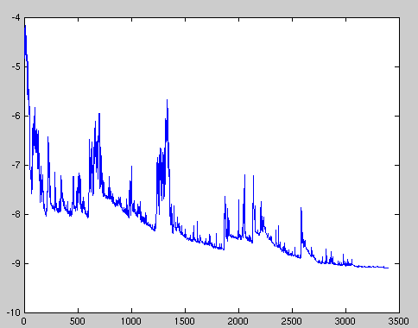
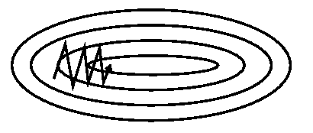
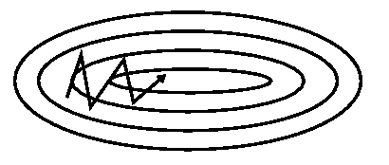
Optimizers
Stochastic Gradient Descent(SGD) :
Instead of using all dataset, one may use part of dataset to update parameters in one step
SGD is an extreme case of mini-batch size 1.
Usually very noisy. ( not all steps reduce Loss/Cost)
Mini-batch SGD: between full-batch and SGD. Can be more efficient than GD. Reduce amount of noise.
GD with momentum : “momentum” to remember the direction of previous learning
Adaptive methods: change learning rate adaptively
→ AdaGrad, RMSprop, AdaDelta, AdaM …..

Slide 22
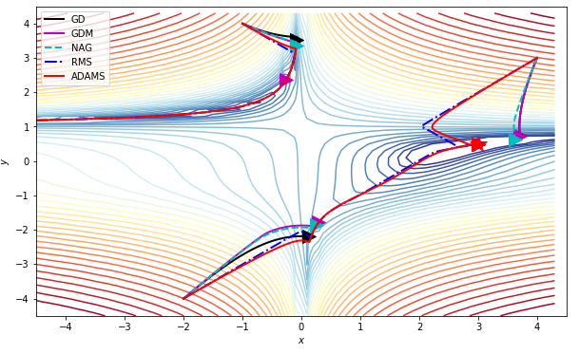
Optimizers
More details on optimizers in Ref. 5.
Comparison of optimizers from Ref.5.
Notebook2 of https://physics.bu.edu/~pankajm/MLnotebooks.html
https://ruder.io/optimizing-gradient-descent/
Adaptive optimization method do not always have good generalization. Simpler procedure like plain SGD may work better in some cases.

Slide 23
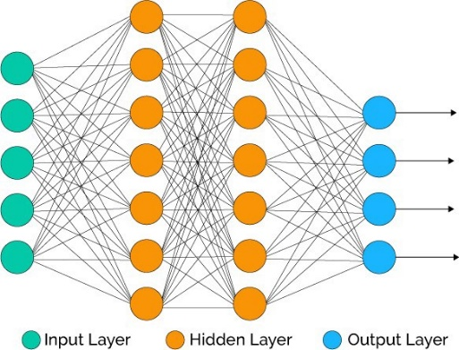
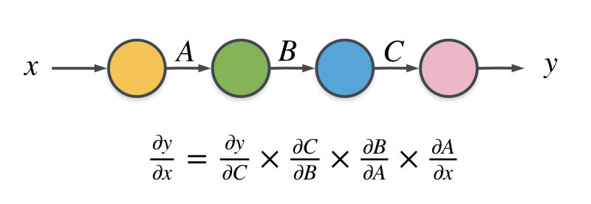
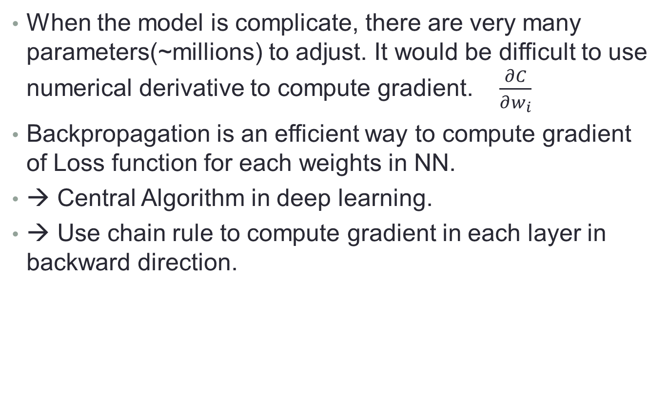
Backpropagation
When the model is complicate, there are very many parameters(~millions) to adjust. It would be difficult to use numerical derivative to compute gradient. $\frac{∂C}{∂w_{i}}$
Backpropagation is an efficient way to compute gradient of Loss function for each weights in NN.
→ Central Algorithm in deep learning.
→ Use chain rule to compute gradient in each layer in backward direction.
Image from https://www.freecodecamp.org

Slide 24
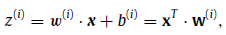
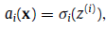
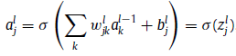
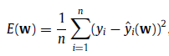
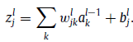
Backpropagation
Output of j-neuron in l-layer
Loss/Cost : MSE case

Slide 25
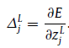
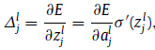
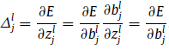
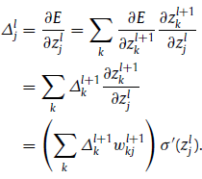
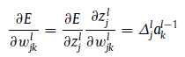
Backpropagation
Define Error in j neuron in l layer
(for last layer L)
Backpropagation Algorithm,
Feedforward.
(compute z and a in each layer)
Error at top layer.
“Backpropagate” errors
Calculate Gradient
(require derivative of Loss function,
Derivative of activation function,
Need to store outputs of neuron.)
Chain rule of Errors in different layers
Gradient of loss w.r.t. weight

Slide 26

Overfitting
Fitting of data is not what we actually want.
We want to apply the model to unknown new data and make a reliable prediction. (generalization)
Model can work poorly when it is underfitted or overfitted.
Depends Model complexity , model’s performance on training data, number of data
→ Simple model can be better if same quality.
Image from blog in medium.com

Slide 27
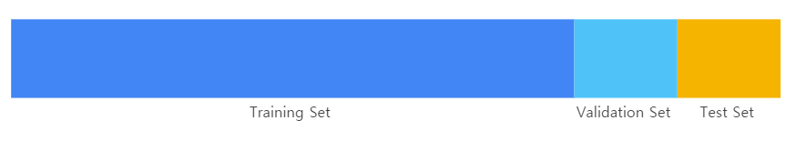
Data preparation
To prevent overfitting : need to monitor generalization
Training Set: data used to train the model
Validation Set: data not used for training model.
use results of validation set for tweaking.
Test Set: Data never used for training/tweaking model.
Always check data : quality of data should be even
Information leaking
Image from Ref.4

Slide 28

Image from Ref.4

Slide 29

Preventing overfitting
Increase data: reduce training of noise in data
Data Augmentation may be useful.
Randomize data
Always check validation error
Early stopping
Image from Ref.4

Slide 30



Preventing overfitting
Decrease model complexity :
more complex model , more likely to overfit
Regularization : constraint weights
L1 regularization
L2 regularization
Drop out : omit random neurons in training
Batch Normalization:
additional “BatchNorm” layer
Image from Ref.5.

Slide 31
Exercise 1
Being familiar with
Python
Jupyter notebook/ Google colab
Keras, Tensorflow
Simple case of regression using NN
MNIST hand writing classification using NN

Slide 32
Requirements
Python
Recommend to install Anaconda (Python 3)
You may use Jupyter Lab/Notebook
Packages/libraries : numpy, scipy, matplotlib, pandas and so on
Google colab is also convenient
For NN(and other ML)
Keras, Tensorflow, PyTorch , scikit-learn, …
Link to Github Repository
https://github.com/alphacentaury-github/NPSS2020

Slide 33
Lecture 2

Slide 34

Convolutional Neural Network (CNN)
Simple NN input is a 1-dimensional vector.
In case of image input, the input is flattened to be 1-d.
CNN use the 2-dimensional structure of image(locality) and symmetry (translation invariance).
CNN improved the image classification greatly.

Slide 35




Convolutional Neural Network (CNN)
Kernel/Filter: weights only depends on the distance
→ Apply the same weights to different neurons
Convolution: Slide the filter over inputs
Extract particular local features of image
size of the patch/filter
depth of the output feature map (number of filters)
Filter can be trained
filter is element-wise multiplication and sum
After convolution ReLU is applied to feature
Image from ref.1 , 3 and 4

Slide 36

Convolutional Neural Network (CNN)
Subsampling/Pooling
Downsamples the convolved feature, reducing dimension
Maxpooling , AveragePooling
Fully connected Layers
Do classification
Output layer use softmax activation function
Image from ref. 4

Slide 37
Unsupervised learning
If there is no labels in data, how one can train the model?
Can machine to figure out there are different classes of data on its own? ( Supply images of cats and dogs. Can machine find out there are two classifications?)
→ Make the model to simulate the inputs.
→ Place a bottleneck of information( fewer neuron in a hidden layer than input layer) : compress/encode information.
→ Latent space : dimensionality reduction
→ If one can re-construct the original data from compressed information, there would be no information loss.
→ If two points in latent space are close, we may think they would have similar characters. (classification.)

Slide 38

Autoencoder
Unsupervised Learning (Generative model)
→ Dimensionality reduction in latent space
→ Try to find best encoder/decoder pair(keep maximum information encoding, minimum reconstruction error decoding)
https://towardsdatascience.com/understanding-variational-autoencoders-vaes-f70510919f73

Slide 39
Autoencoder
The training may be done with inputs and some desired outputs.
For example, black-white image inputs and colored image outputs. (still no human labels) → Trained machine can be used to colorization of black-white images.
Once the Autoencoder is trained, one can use it for classification.
Re-use the encoder layers. +add one more layer for classification(output in latent layer may have important features)

Slide 40

GANs
Generative Adversarial Networks(GANs)
One of unsupervised learning method
Generator and Discriminator tries to win each other.
https://developers.google.com/machine-learning/gan/gan_structure

Slide 41
More advanced topics

Slide 42

Bayesian NN
A way to make the NN to say “I don’t know”
The NN can give overly confident answers.
Introduce probabilistic inference (distributions, uncertainty)
Bayes theorem
X: event
Theta : Hypothesis
(we want to confirm)
Prior : Prior belief in hypothesis
Likelihood: probability x under theta
Evidence: probability x occur
Posterior: Post belief in hypothesis
after seeing event
From https://towardsdatascience.com/bayesian-inference-problem-mcmc-and-variational-inference-25a8aa9bce29

Slide 43



Bayesian NN
Usual NN is a Maximum Likelihood Estimation(MLE)
with Gaussian distribution
Maximum a Posteriori (MAP) weight corresponds to regularization with Gaussian prior
Bayesian inference gives a distribution, not one number
→ distribution gives uncertainty of prediction

Slide 44



Bayesian NN
In a sense, BNN can prevent overfitting
Evidence is difficult to obtain in many cases
Prediction/inference can be difficult for a new event ,too.

Slide 45



Bayesian NN
One may use
Markov Chain Monte Carlo(MCMC) : Generate samples according to distribution
Variational Inference(VI) : approximate posterior with family of known distribution
http://krasserm.github.io/2019/03/14/bayesian-neural-networks/

Slide 46

Bayesian NN
Variational inference is equivalent to change
Point weights w → Distribution of w ~ N( m, sigma)
Increase number of parameters twice.
Then, output of the network is also distribution.

Slide 47

Variational Auto encoder (VAE)
Add Variational layer: distribution over weights.
https://towardsdatascience.com/understanding-variational-autoencoders-vaes-f70510919f73

Slide 48



Support vector Machine
ML method for classification
Hyperplane is determined
by a vector w and b.
Maximize margin = b/||w||
under condition

Slide 49




Support vector Machine
Suppose solution and change problem using Lagrange dual form
Support vector : x_i which has non-zero alpha_i( close to hyperplanes)

Slide 50



Support vector Machine
Previous example only get linear form
Extends it to non-linear form by introducing
basis functions
The solution is determined by data x_i, y_i and kernel
One only needs kernel function for a prediction at new points

Slide 51



Gaussian Process
Non-parametric method : parameters are determined by the data.
Training is faster than non-parametric methods. (Only to remember data)
Inference can be slower.( Need to process all training data for prediction)
Example: Lagrange interpolation. Nadaraya-Watson kernel regression.

Slide 52



Gaussian Process
Gaussian process : defines prior over functions and
infer a distribution over functions.
I am not going into details of Mathematical descriptions
Inference : Posterior distribution
Usually, it is done by using parametrization of function
In GP modelling, use prior directly on the space of functions
without parametrization.
Prior over function is defined by joint Gaussian distribution with
mean function and covariance or kernel function

Slide 53




Gaussian Process
.
Kernel function describes
Correlation between function values
At two points.
smooth functions
Similar to Green’s function
Prior( Kernel function) determines the properties of GPs.

Slide 54




Gaussian Process
Joint distribution of observation and prediction
Posterior distribution is also Joint Gaussian distribution !!
One only have to find posterior mean and covariance
RBF kernel

Slide 55


Gaussian Process
Image from “Gaussian Processes for Machine Learning”, MIT press

Slide 56

Gaussian process
squared exponential (or radial basis function or Gaussian)
calibration or simply Bayesian inference for the model parameters
→ find the θ(hyper parameters) that produce the best fit in interpolation/regression. ( finding the posterior for θ )

Slide 57
Exercise 2
CNN
BNN
GANS
VAE
Gaussian Process
Link to Github Repository
https://github.com/alphacentaury-github/NPSS2020

Slide 58
Lecture 3

Slide 59
Applications to Nuclear Physics
Various ML techniques applied to nuclear physics
In experiments, it can be used to control devices, classify data, triggering/detecting important event and so on…
Here let us look at several applications in theoretical nuclear physics.
This is not complete review of current status of application of ML in nuclear physics. Just some examples.

Slide 60
Applications of ML to interpolation/extrapolation of
(From arXiv:2006.05422v1 )
Nuclear masses
Charge Radii
Excited States
Beta Decay
Alpha Decay
Fission Yields
Nucleon-Nucleon Phase shifts
Neutron-alpha scattering and three-body parameters
Nuclear reaction cross sections
Estimates of truncation errors
Model calibration and reduction
Variational calculations

Slide 61



Nuclear Mass models
Statistical model study of nuclear mass

Slide 62





Slide 63





Slide 64



Hybrid Model:
Train NN with the difference
Between experiment
and theoretical model(FRDM)

Slide 65








Train mass residuals with BNN
→ Possible to estimate theoretical uncertainty

Slide 66


Theoretical Error estimation
Applied to NS
crust

Slide 67






Slide 68



Training of residual two-neutron separation energy
For BNN (one hidden layer 30 neurons) and GP.
Input data were smoothed with Gaussian folding to get general trends

Slide 69



Slide 70



Bayesian
Gaussian Process
Bayesian Model
Averaging

Slide 71



Extrapolation in
Model space of NCSM calculation
(Nmax,
Try to explore hyper-parameter space
To find best 50 models

Slide 72




Inputs:
Charge and Neutron number of Fission nuclei
Mass of fission fragment
Excitation energy of the compound nucleus
Output: Fission Yield

Slide 73






Gaussian Process
For truncation error of EFT
“c” are not LECs in theory

Slide 74





arXiv:1911.13092v1
Variational ANN

Slide 75



Train NN to learn EDF results
Fast emulator
model HFB calculation with five-dimensional collective Hamiltonian approach
Train 5DCH parameters with Committee of NN
Data Selection scheme to make HFB calculation

Slide 76



arXiv:2003.10770v1
Train NN to classify pole of amplitude
: training data constructed from pre-defined S-matrix structure
And tested with realistic NN potential scattering

